Slide 1
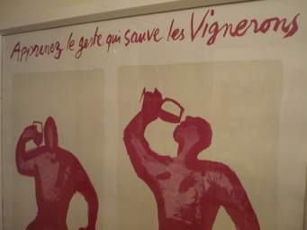
C’est la vie wine tasting – loire

Slide 2
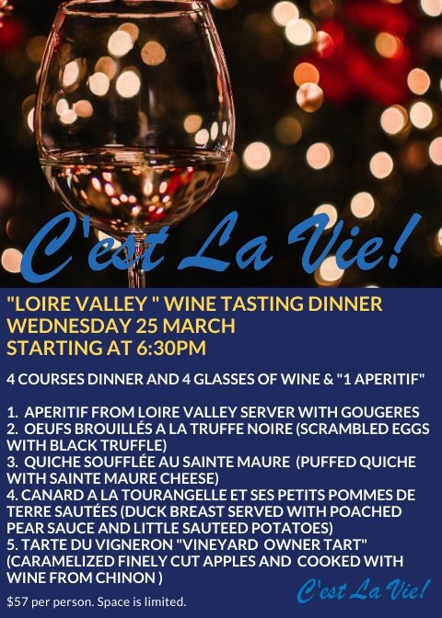
A gougère is a baked savory choux pastry made of choux dough mixed with cheese. There are many variants. The cheese is commonly grated Gruyère, Comté, or Emmentaler
Scrambled eggs with black truffle oil. Loire Valley is a famous place to have blacks truffles, in the Richelieu region. The last market in Marigny Marmande is in February. It's a colourful and tasty event
The goat cheese AOC Sainte-Maure de Touraine is the "city of cheese", a gastronomic must-stop for discovering, directly from the producers, a largely rural area. In a quiche it is a perfect choice !
Specialty from Tours, the duck is prepared with pears. The caramelized pear juice is used for the sauce. The Loire Valley is famous for its pears especially in Rivarennes (Indre et Loire)
La tarte du Vigneron is an apple tart, the apples are previously cooked in Loire Valley red wine, and caramelized. This a specialty of the patisserie Ayrole

Slide 3
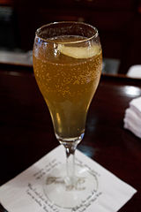
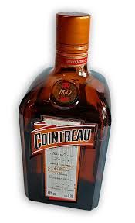
Soupe angevine :
The soupe Angevine is a French cocktail, typical from the Anjou area (Angevine means from Anjou)
The composition is made :
  Sparkling wine from Loire Valley
  Triple sec as Cointreau
  Cane sugar
  Lemon juice
This cocktail has been the inspiration for the soupe Champenoise, the sparkling wine used is Champagne

Slide 4
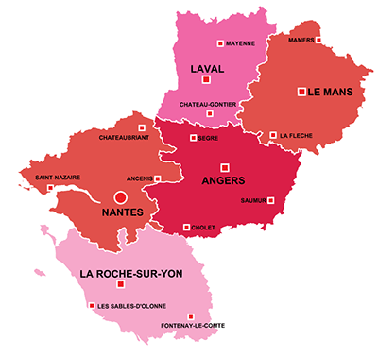
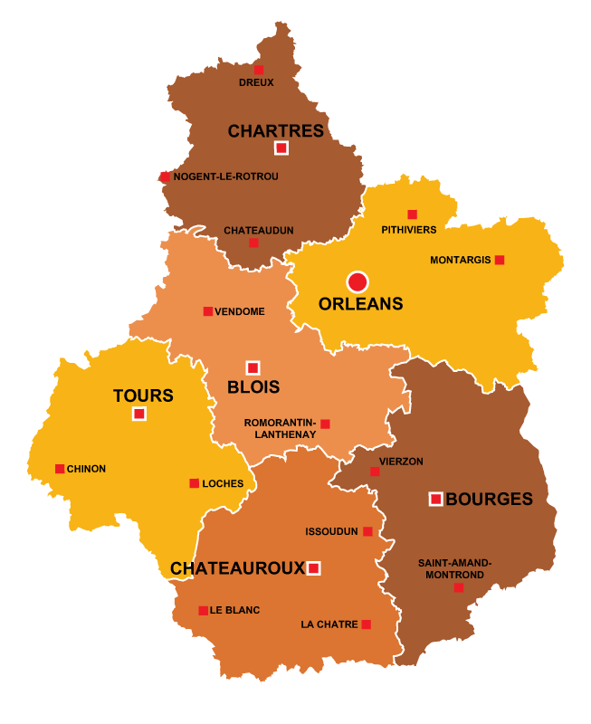
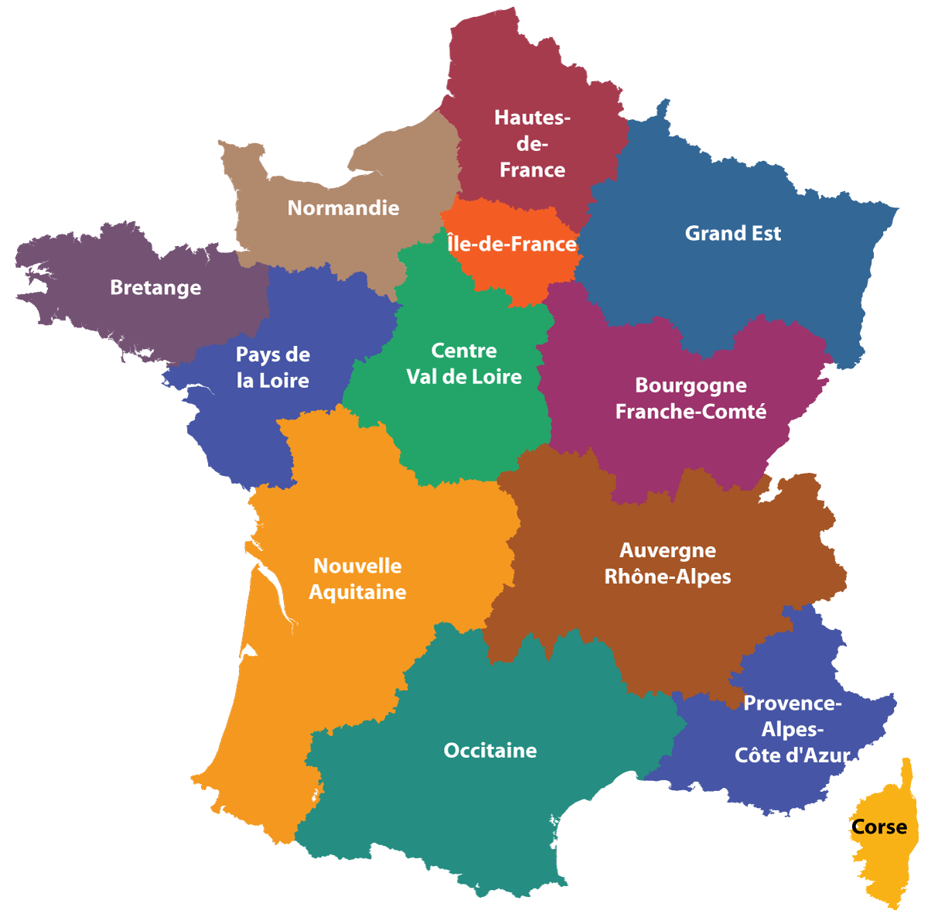

Slide 5
Loire valley : a wonderful region
The Loire Valley is the biggest area in France ever to be included in UNESCO’s world heritage list
Kings, artists and famous authors have fallen under the spell of the Loire and taken up residence on its banks in their droves
Celebrated by Rabelais, venerated by Gargantua, the cuisine of the Loire Valley region, and more precisely of Touraine and Berry, is an institution in itself
Loire à Vélo (Loire By Bicycle) consists of 800km of signposted and secure tracks, running from the village of Cuffy near Nevers, to St. Brévin-les-Pins on the edge of the Atlantic Ocean
There are no less than three natural parks : the Brenne, the Loire-Anjou-Touraine and the Perche, that are punctuated by rivers and rolling green valleys
The Loire Valley conjures up a dreamlike landscape of sumptuous chateaux and cathedrals along the Loire, a wild river which can also be explored by boat.

Slide 6
Nantes : one of the favorite city in france
Nantes is situated at the head of the estuary of the Loire River, where it is joined by the Erdre and the Sèvre rivers, 35 miles (56 km) from the sea and southwest of Paris. It is one of the French towns that has changed the most in the 20th and 21st centuries
10 years ago, Nantes was the favorite city for French people, now it is the second one after Bordeaux
Greatly modified by an urban renewal plan that was adopted in 1920, Nantes was further altered and extended after having been partly destroyed in World War II. In the 1960s Nantes was designated as one of the eight provincial counterweights to reduce the dominance of Paris on French national life
A large scientific park, created in 1987, was designed to foster the new modern activities. Nantes is also a major business center and is the home of many regional headquarters of both industrial and services firms

Slide 7
Loire valley : castles everywhere !!
The Château de Chambord, in Chambord, Loir-et-Cher, France, is one of the most recognizable châteaux in the world because of its very distinctive French Renaissance architecture which blends traditional French medieval forms with classical Renaissance structures. The building, which was never completed, was constructed by Francis I
The Château de Chenonceau is a French château spanning the River Cher, near the small village of Chenonceaux in the Indre-et-Loire département of the Loire Valley in France. It is one of the best-known châteaux of the Loire valley, The estate of Chenonceau is first mentioned in writing in the 11th century. The current château was built in 1514–1522 on the foundations of an old mill and was later extended to span the river
The Royal Château de Blois is located in the city center of Blois at the Loir-et-Cher department in the Loire Valley. The residence of several French kings, it is also the place where Joan of Arc went in 1429 to be blessed by the Archbishop of Reims before departing with her army to drive the English from Orléans. There are four architectural styles represented at the Chateau of Blois
The Château d'Amboise is located in the Indre-et-Loire département of the Loire Valley in France. Confiscated by the monarchy in the 15th century, it became a favoured royal residence and was extensively rebuilt. King Charles VIII died at the château in 1498 after hitting his head on a door lintel.. It has been recognised as a monument historique by the French Ministry of Culture since 1840. The Château d'Amboise is situated at an elevation of 81 meters

Slide 8
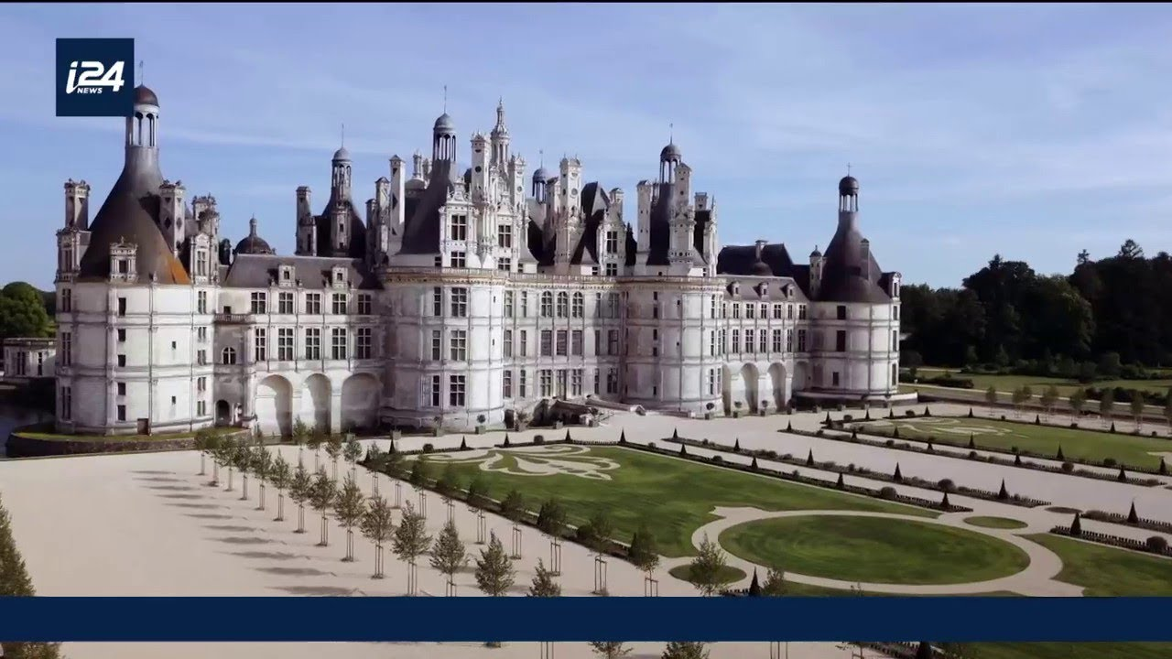
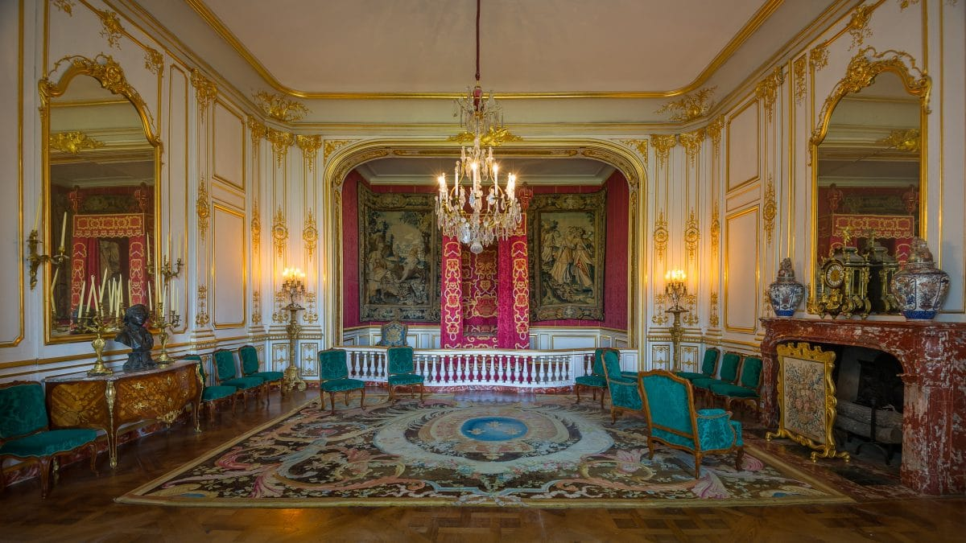
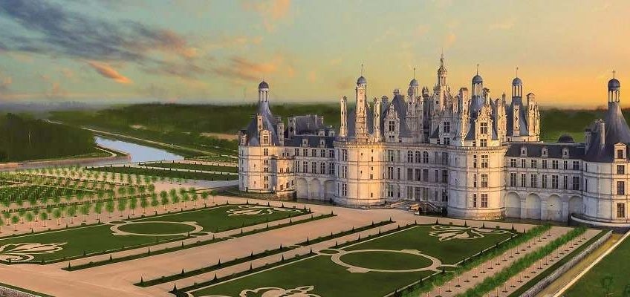
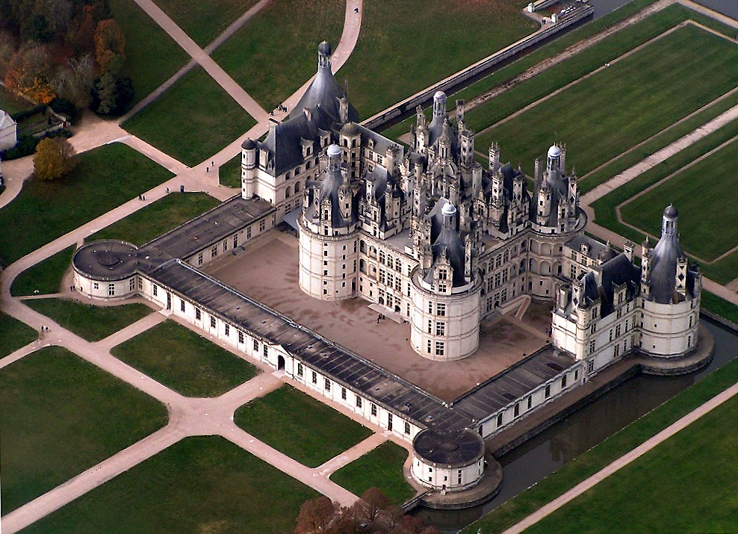
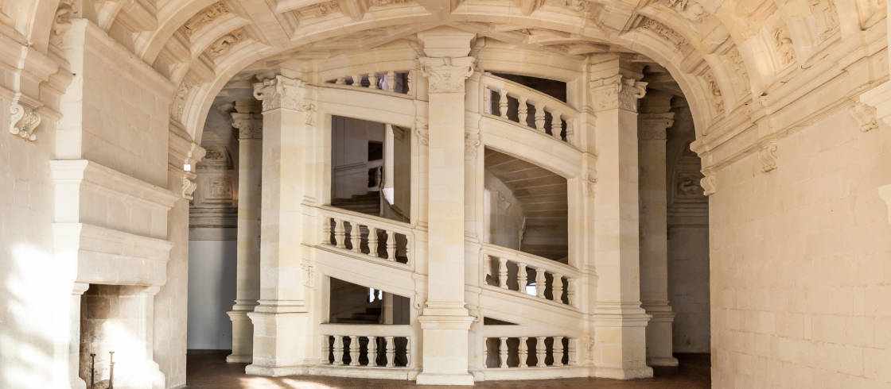

Slide 9
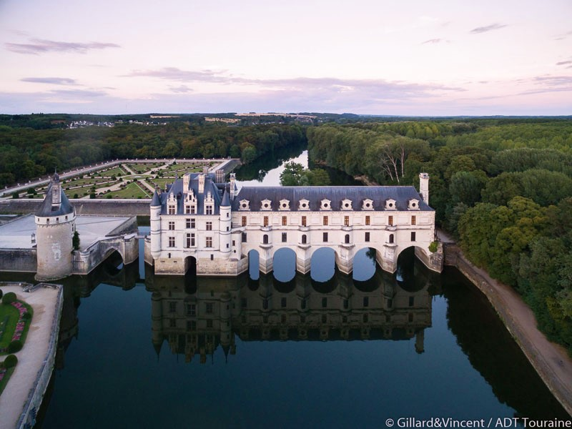
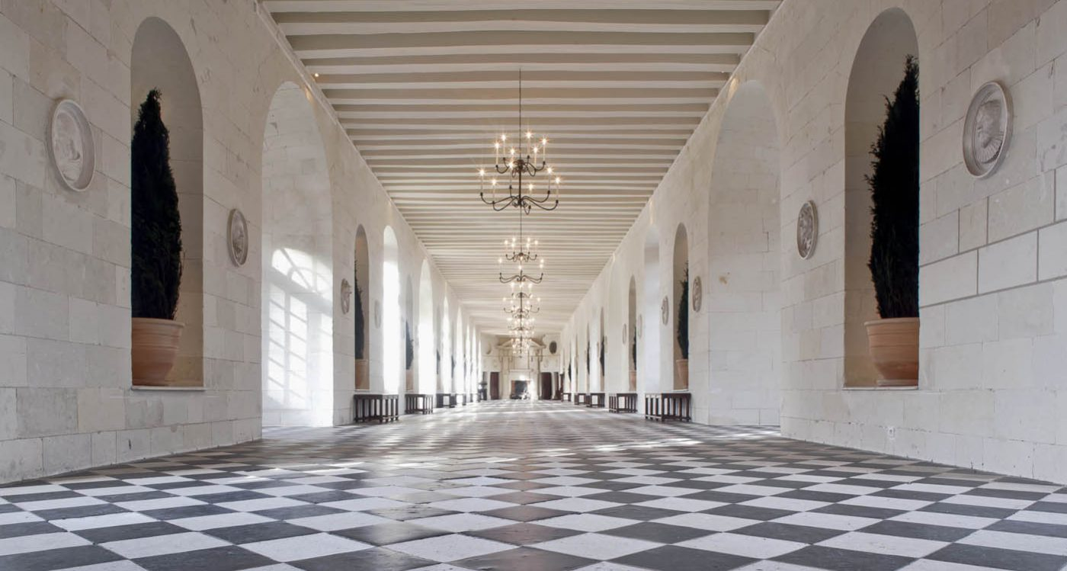
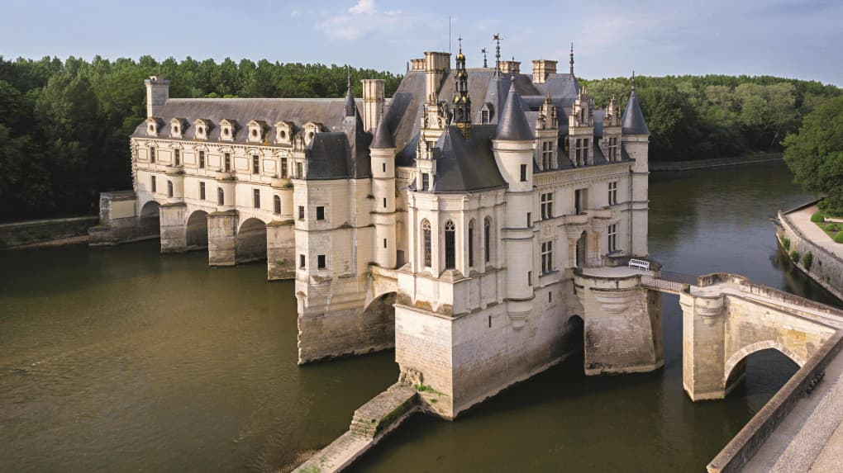
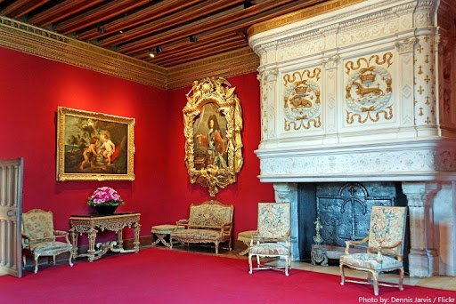
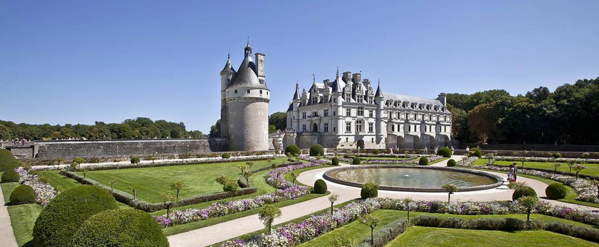

Slide 10
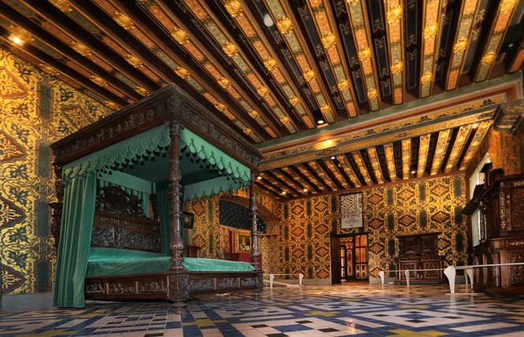
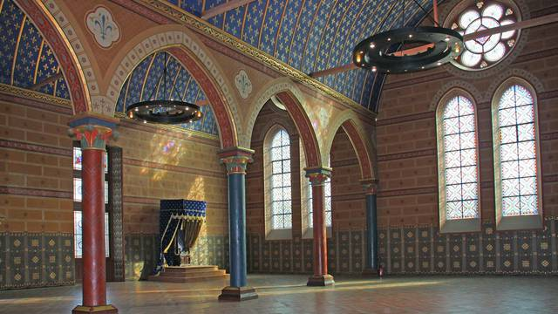
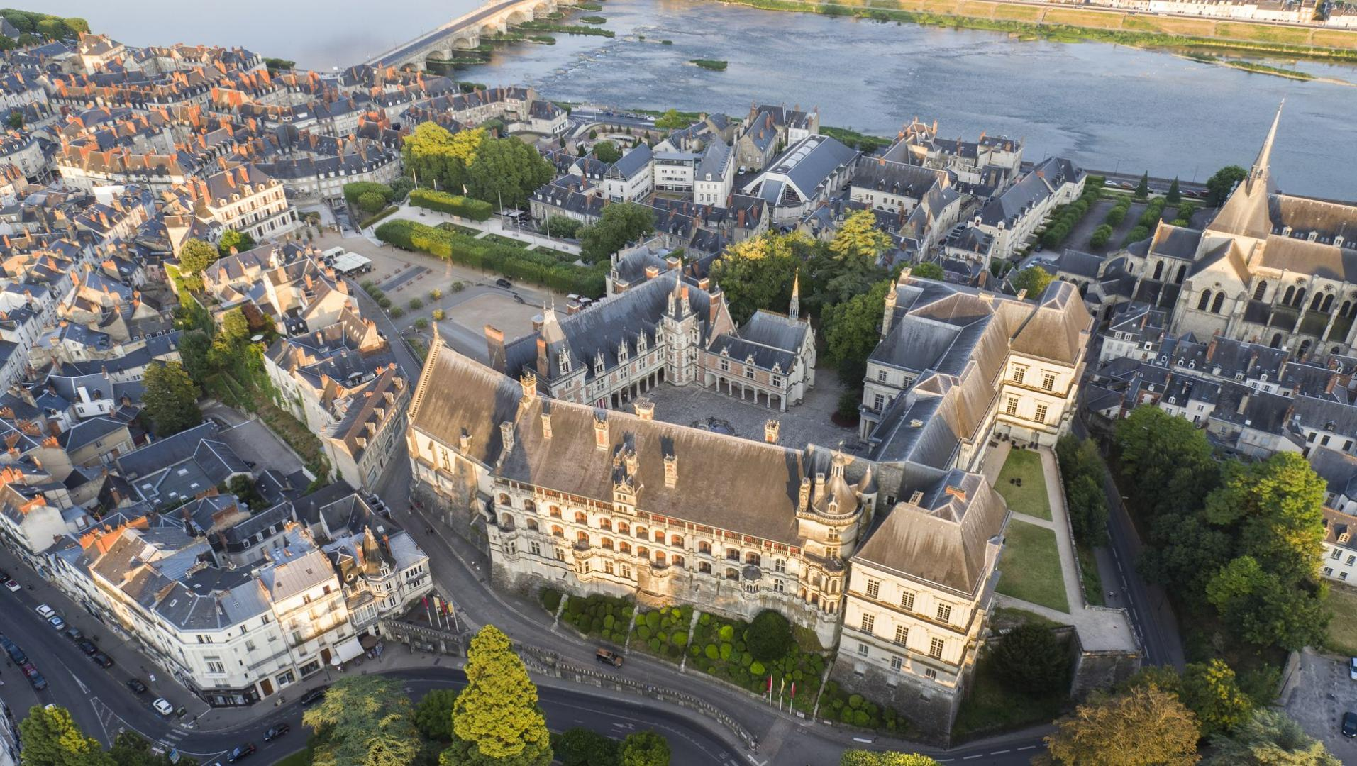
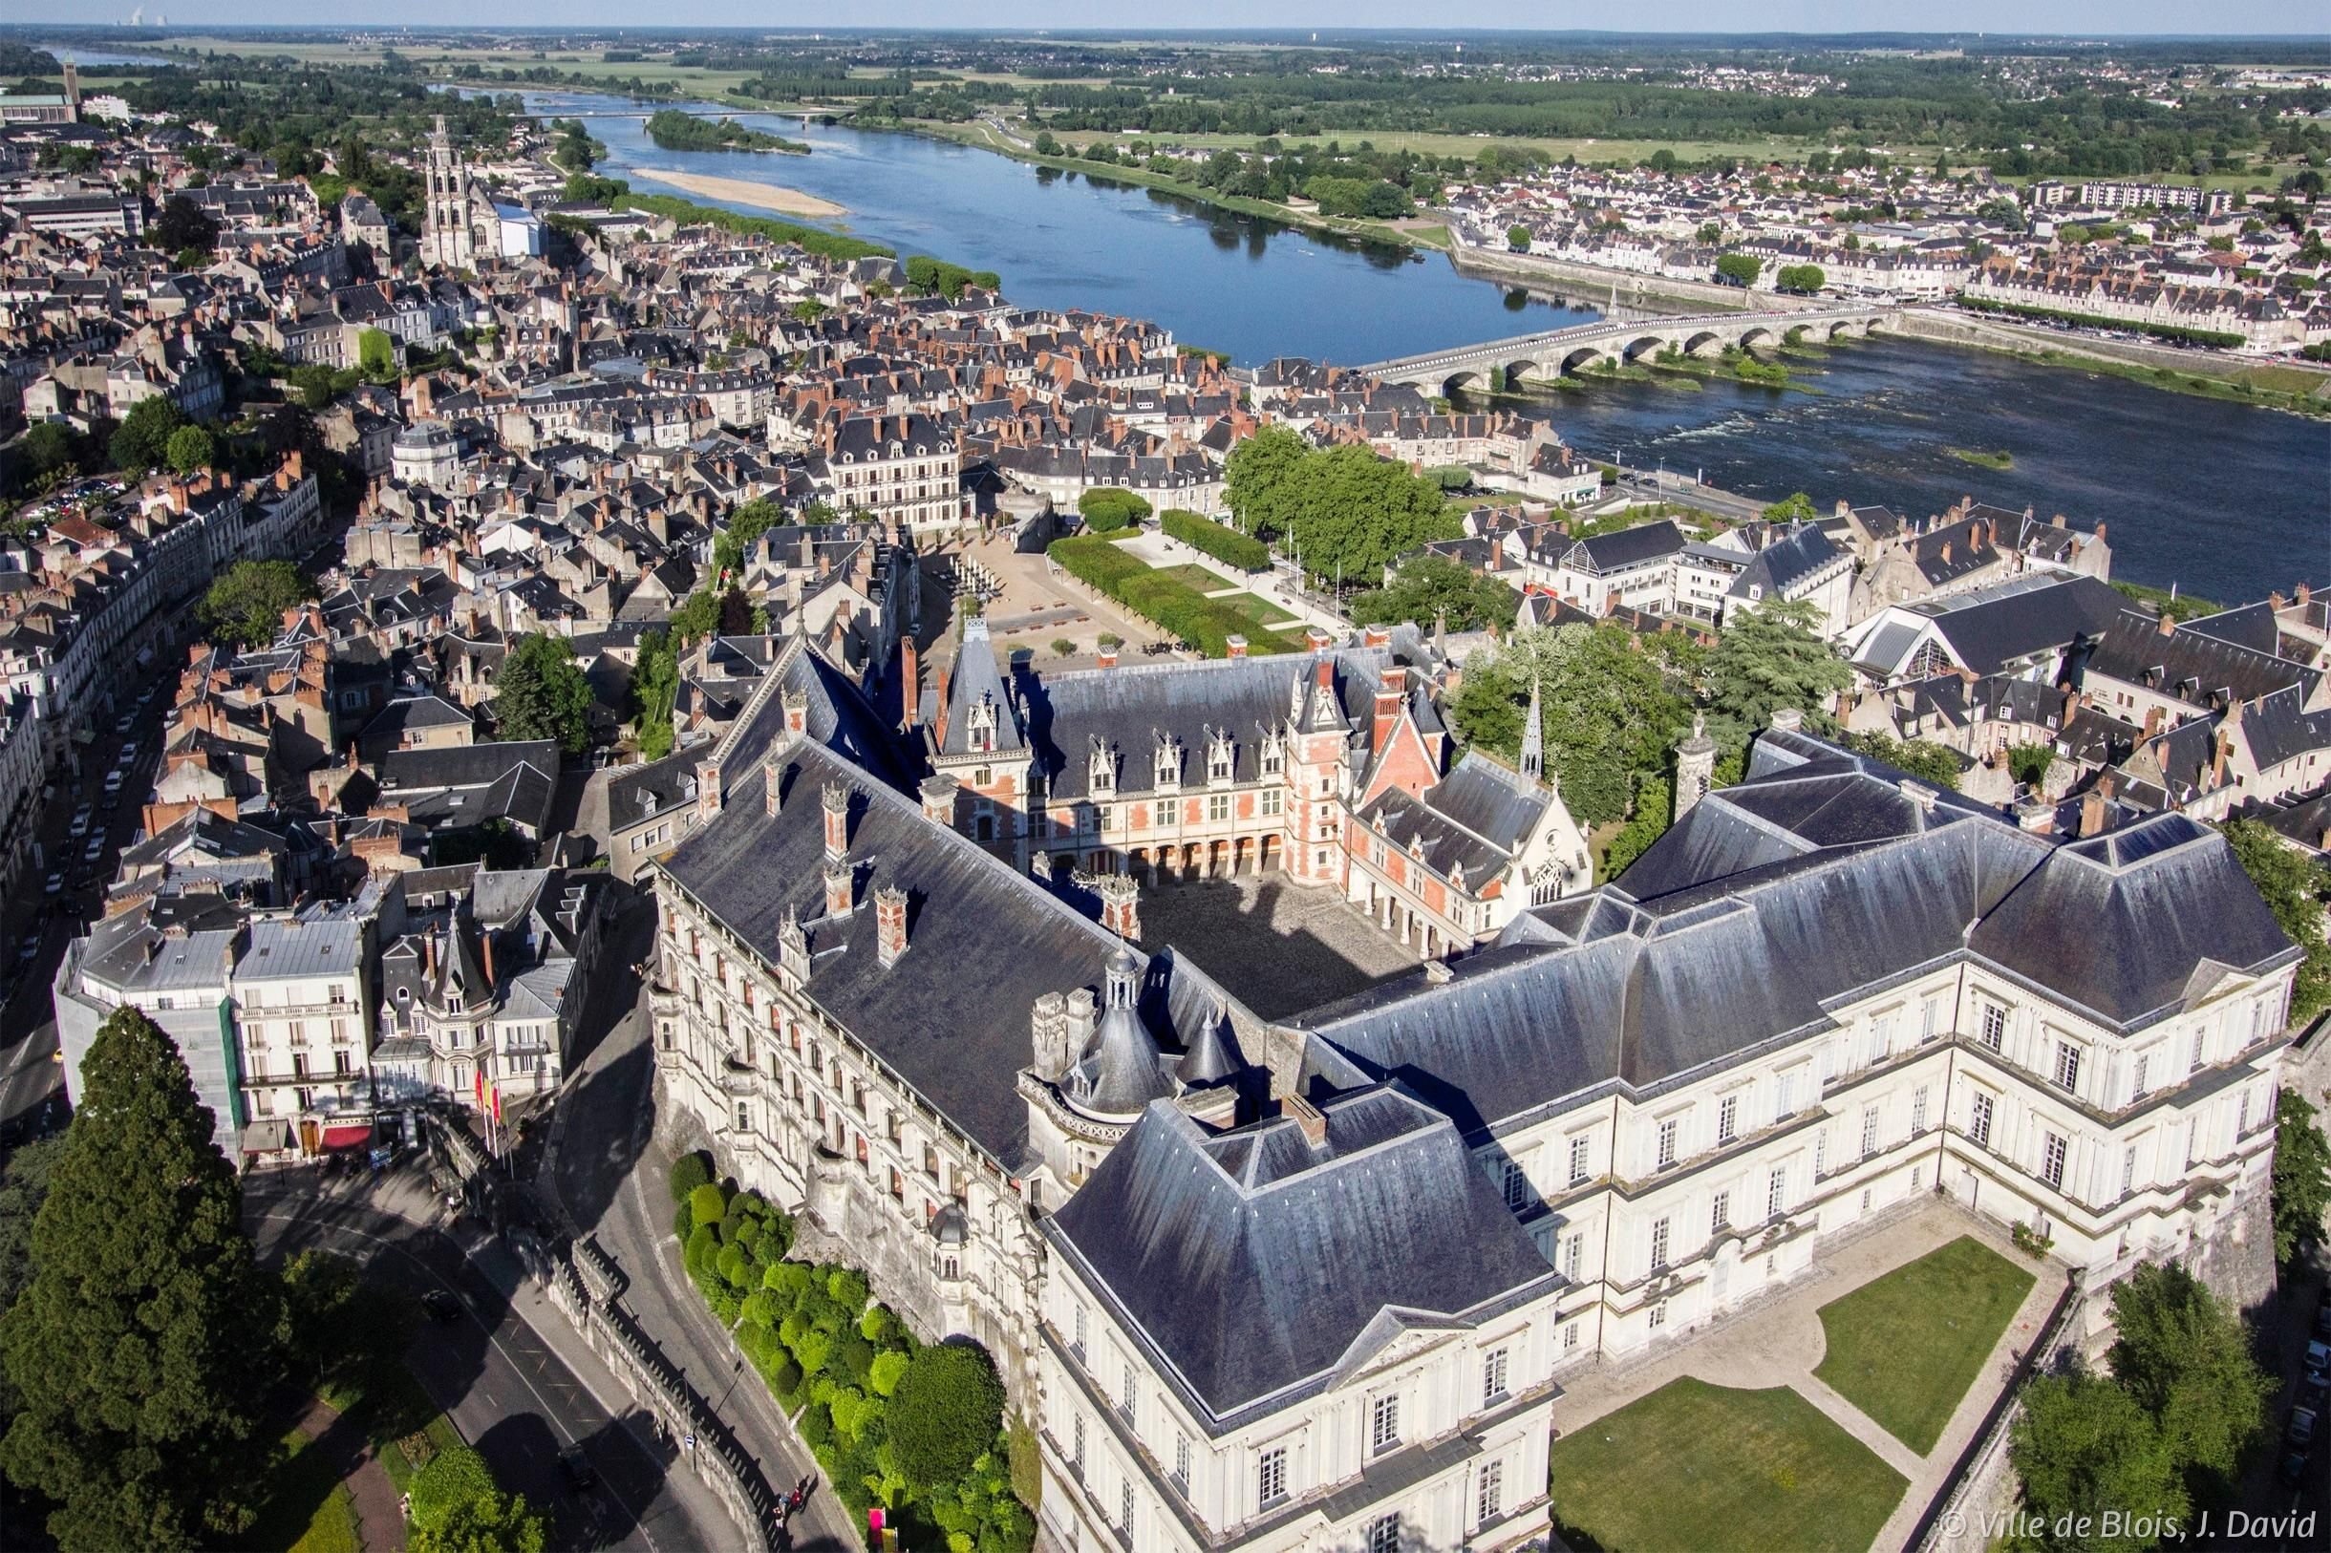
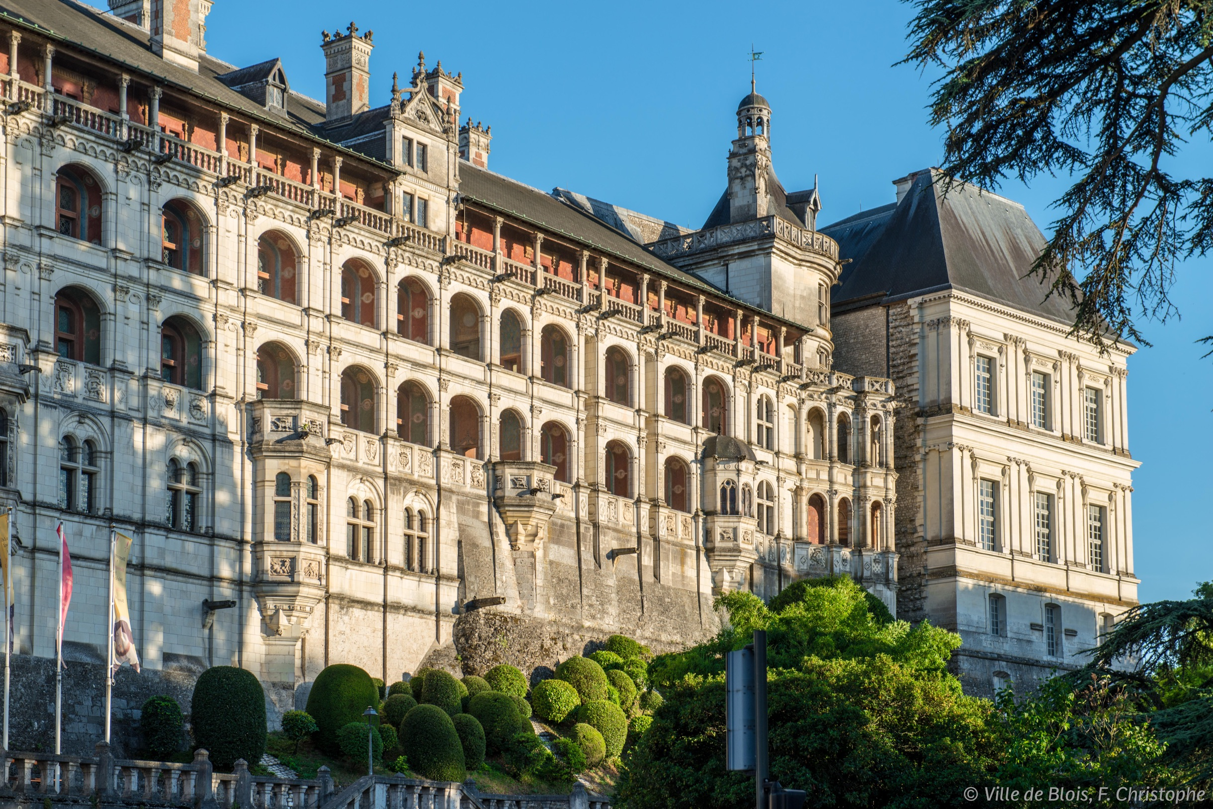

Slide 11
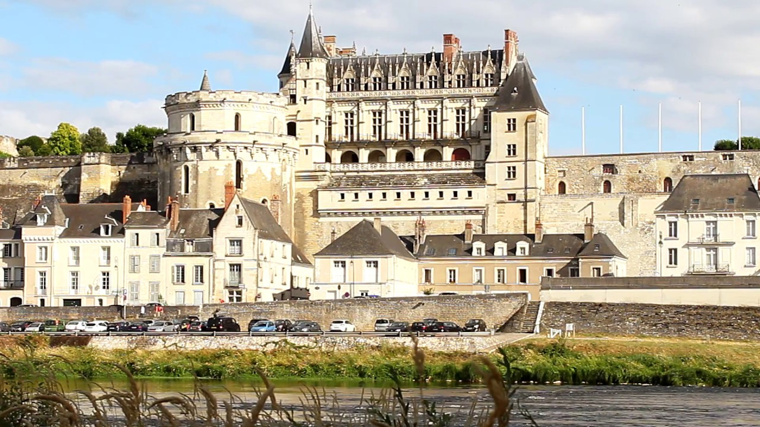
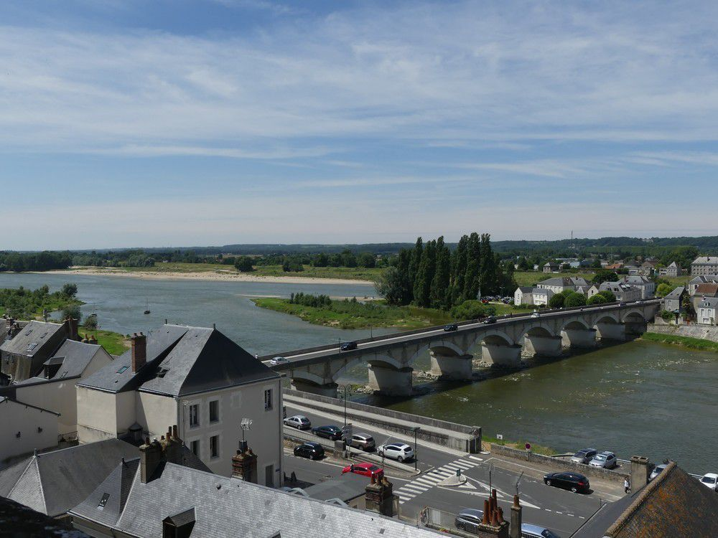
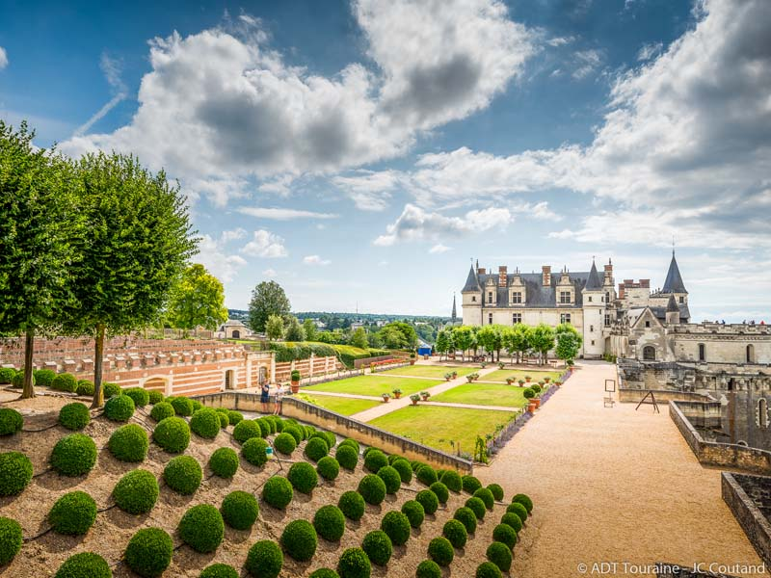

Slide 12
Loire valley vineyard
The Loire is one of France’s biggest wine regions, following the course of the Loire (France’s longest river, with a total length of 1,000 km) until it reaches the Atlantic Ocean, off the coast of Brittany. The Loire River is roughly in the centre of France and crosses major historical cities, including Orléans, Blois, Tours and Angers.
No. 1 Biggest producer of French AOC white wines
No. 1 Biggest AOC region for French sparkling wines (excluding Champagne)
No. 2 Second biggest producer of French AOC rosé wines
61 Appellations and Denominations
420 million bottles per year, 4,000 wineries, 160 trading companies, 15 cooperatives

Slide 13
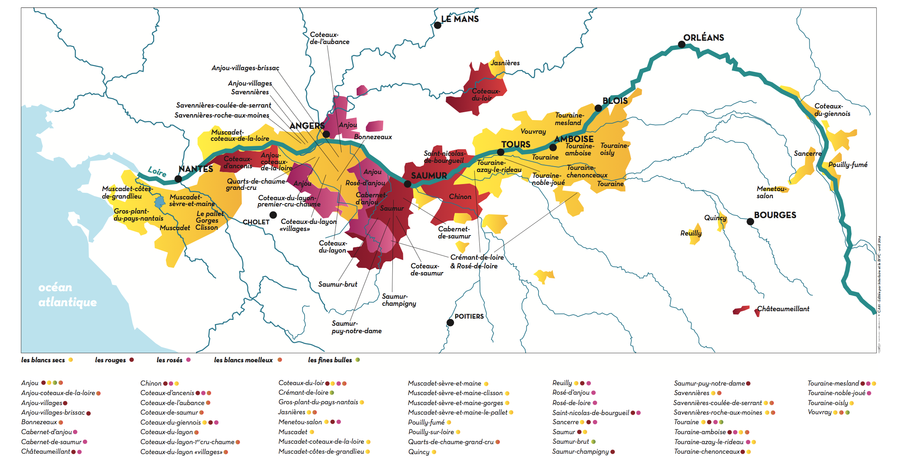
Loire valley vineyard

Slide 14
Loire valley wines quick facts
Almost half of the wines that come out of this region are white wines. Not into white wines? High-quality reds, whites, rosés and sparkling wines are also grown and produced here
If you like a variety of wines to choose from, dig into the 24 different grape varieties found in this region. The main red wine grapes are Pinot Noir and Cabernet Franc, while the majority of white wines are made from Chenin Blanc, Melon de Bourgogne and Sauvignon Blanc
Loire Valley wines tend to have a lower alcohol content than other wines. It’s the perfect wine to serve throughout a long dinner party so that guests can enjoy a glass or two (or 4 ☺) with all the different courses of a meal and not feel like they are over consuming

Slide 15
Loire VALLEY grapes
White grapes
Red grapes
Sauvignon blanc
Cabernet franc
Gamay
Chenin blanc
Grolleau
Chardonnay
Pinot noir
Melon
Cot

Slide 16
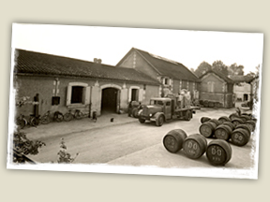
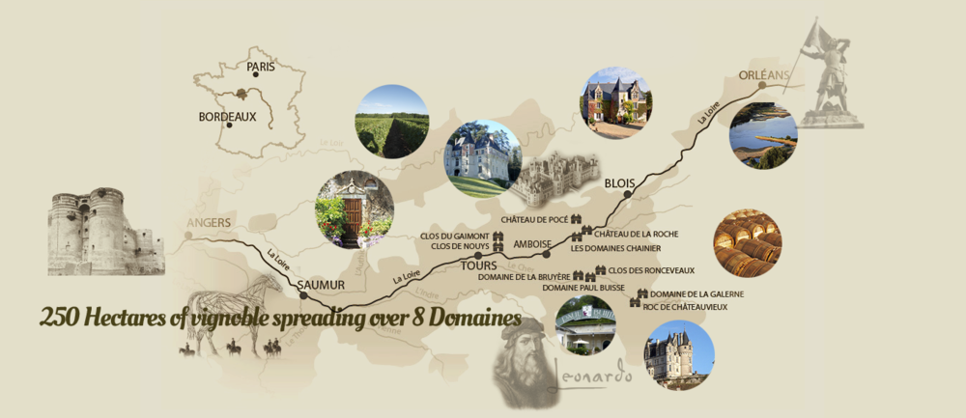
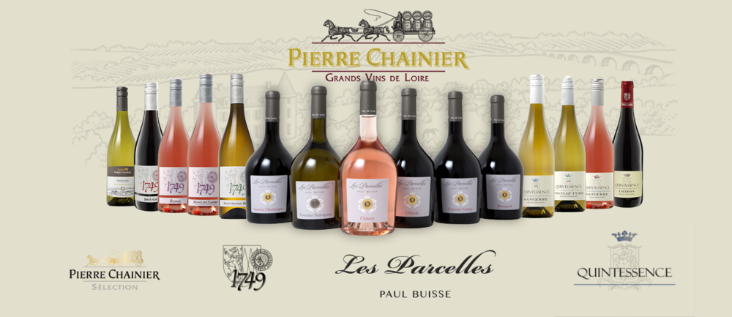
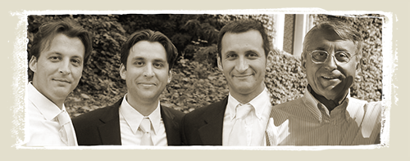
first wine : Muscadet marc dupas les parcelles : PIERRE CHAINIER
The History of the Chainier family starts in the 18th century when the ancestors of Pierre Chainier cultivated vines in Bordeaux. After several years, it is in the Loire Valley that the Chainier House was founded in 1973
This tradition has been carried from father to sons and the Chainier House now, brings together many professional expert, partners, wineries and major importers
Pierre Chainier is the initiator of rational culture, an approach toward listening to the earth and adapt, one of the Chainier House's cornerstones, the family Chainier transmit to younger generations
The Chainier House: 250 Hectares of vineyards and a leader in production and distribution of Val De Loire's main grapes. The Grapes and soil areas are representative of the Loire Valley and its global reputation

Slide 17
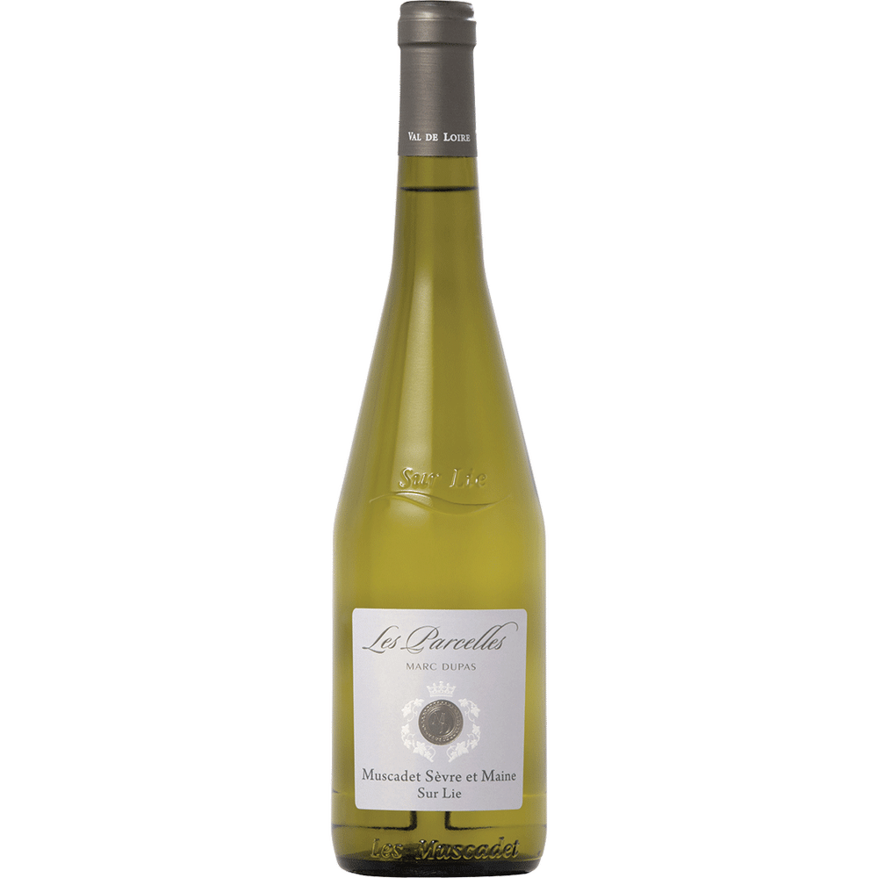
first wine : Muscadet marc dupas les parcelles
Grapes : 100% Melon de Bourgogne
Fresh and Fruity
This light-bodied, dry white Loire wine reveals white flowers on the nose
The elegant palate offers pear and citrus fruit notes. This is ideal as an aperitif or with seafood, white meat and eggs
Simple fruity Muscadet with a zesty texture and easy acidity. Crisp and packed with citrus fruit, it is ready to drink

Slide 18
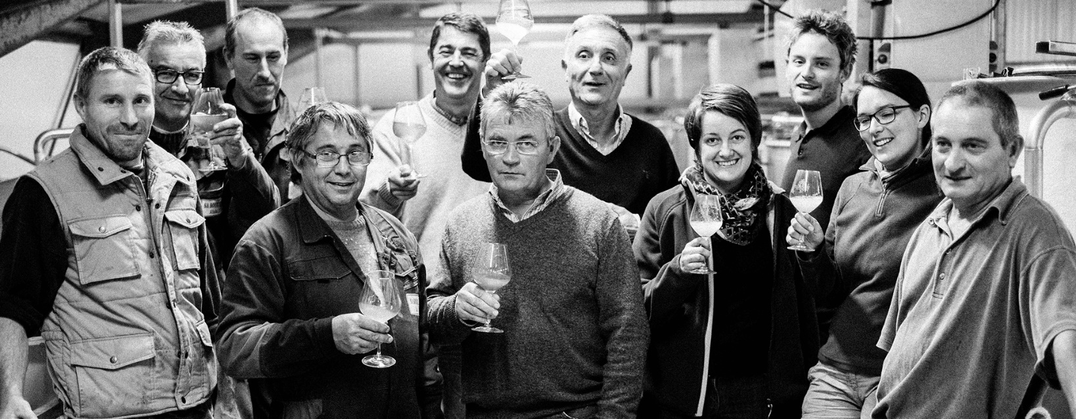
Second wine : Domaine bougrier
Since 1885, 6 generations have shaped the history of the BOUGRIER FAMILY
It all started in 1885, when Achille GUENAULT-COUSIN discovered the “Plateau des Hauts Lieux” in the Touraine region, in the town of Saint Georges sur Cher. A passion was born for this Terroir and for the potential of its wines
Noel Bougrier made it possible to achieve the dream of the previous generations, by widening the cover of the House to the whole Loire Valley from Sancerre to the “Pays Nantais” with the successive creations of our 3 wineries: “Les Caves Tourangelles” in the Touraine region in 1995, “ Les Caves de l’Angevine “in Anjou in 2000 and “ Les Caves de la Nantaise” in Muscadet in 2008

Slide 19
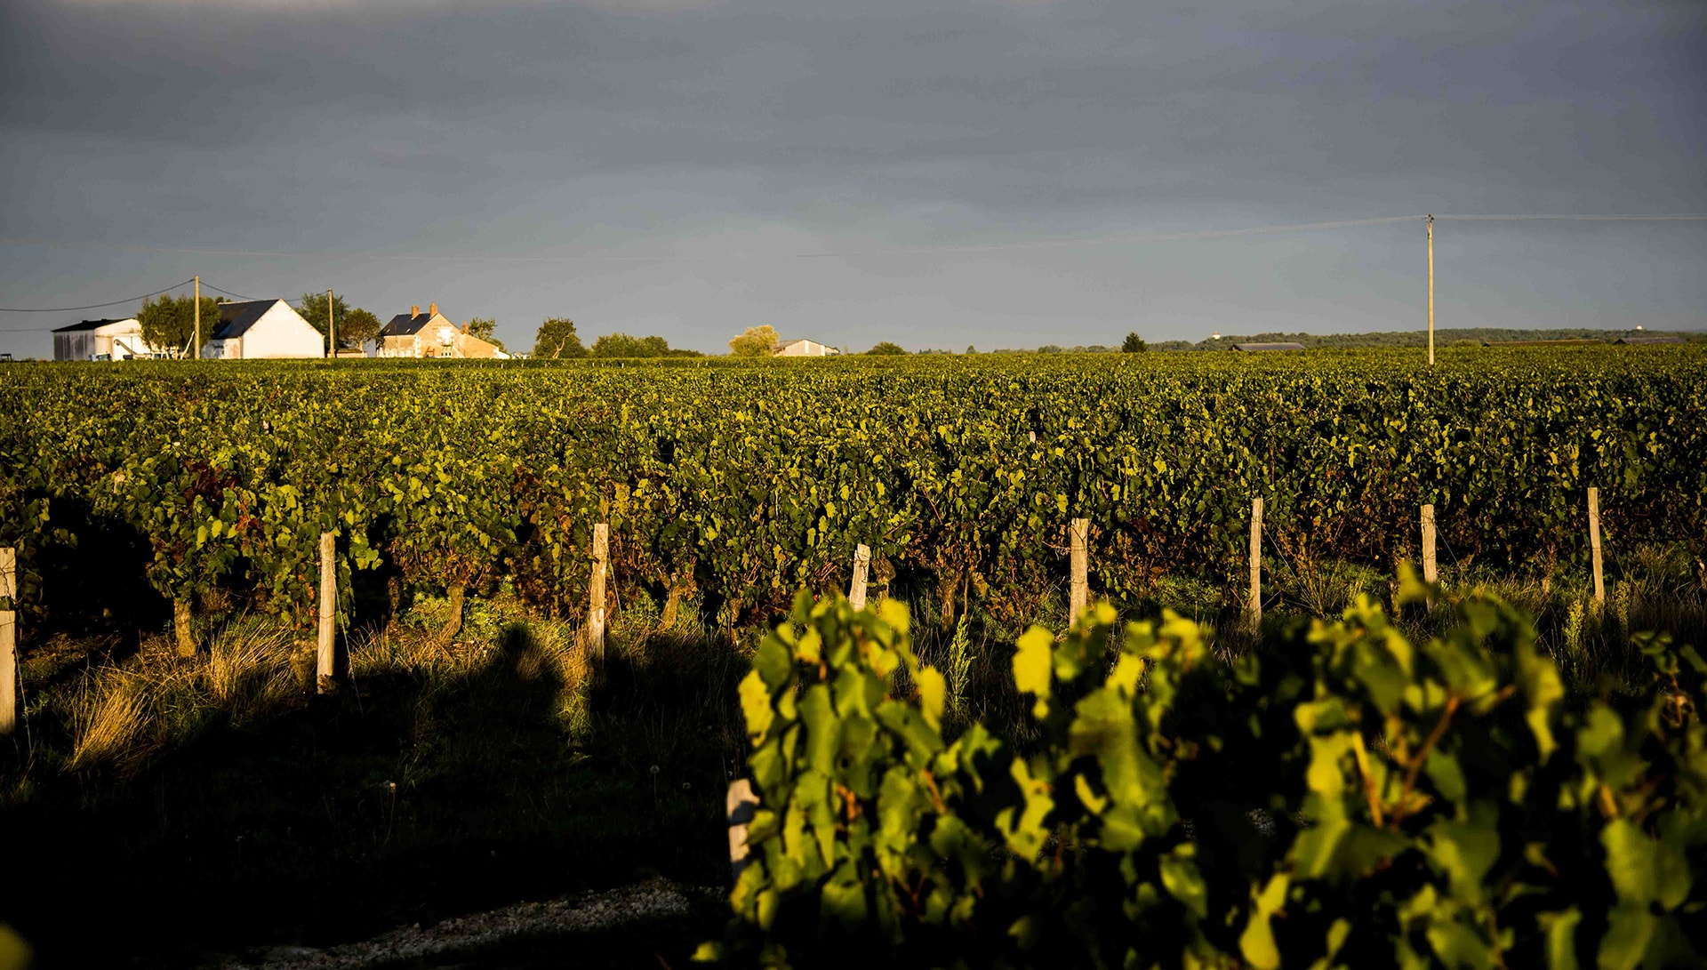
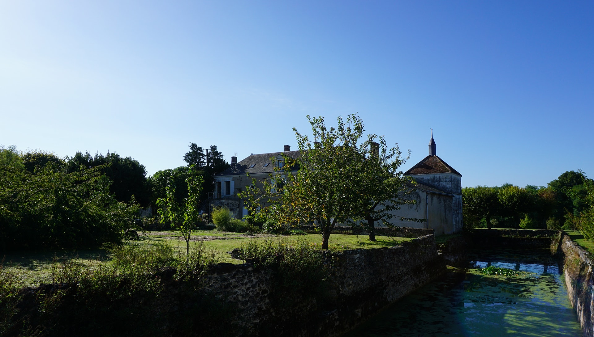

Second wine : Domaine bougrier
In 2015, it was Nicolas BOUGRIER who made his entry into the family home and 2 generations are now working side by side to carry out an only goal: Reveal the best expression of the Loire Valley , with the greatest respect for men and soil. Sophie BOUGRIER, Nicolas’s sister, is never very far to represent the House, in France and abroad
Noel Bougrier works with the wine region to create excellent examples of classic wines
Since 1995, the Bougrier family is rapidly mastering Loire winemaking

Slide 20

Rose de loire pure loire bougrier
Grape : gamay, grolleau
Rose d’Anjou
Light-bodied
Pale salmon in color with a clear meniscus. Very aromatic, with strawberry, rose petal and honeydew melon on the nose
Fresh, fruit-forward and medium-bodied, with med- alcohol. Additional pomegranate and sour cherry notes on the palate
Hint of a mineral finish. Well balanced and a pleasure with pasta or light cheese dish or on its own

Slide 21
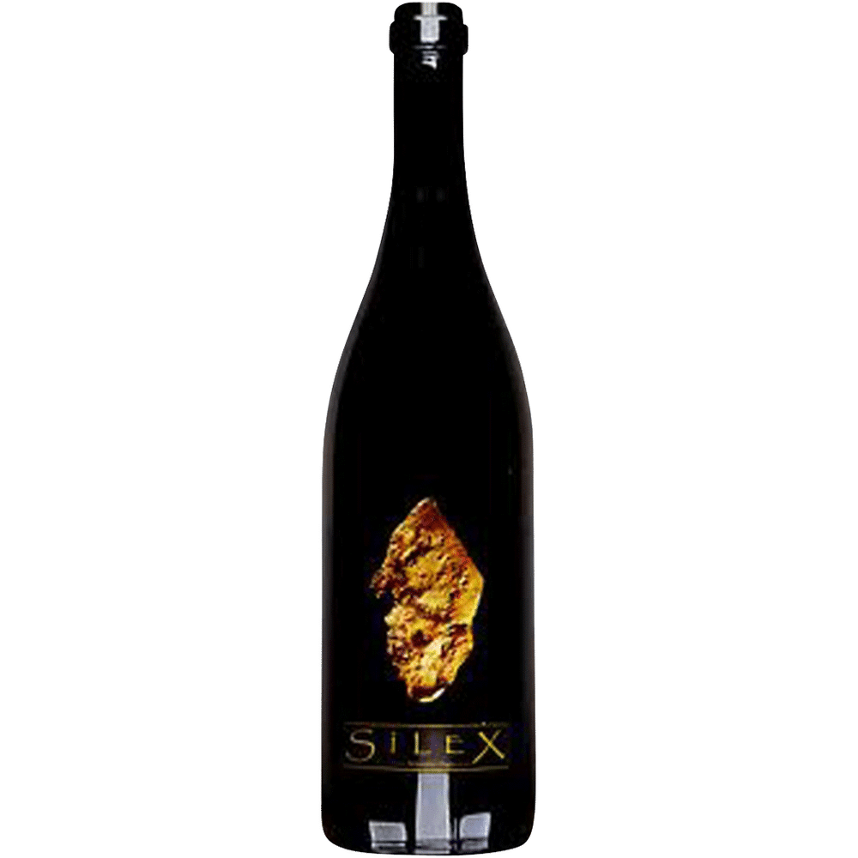
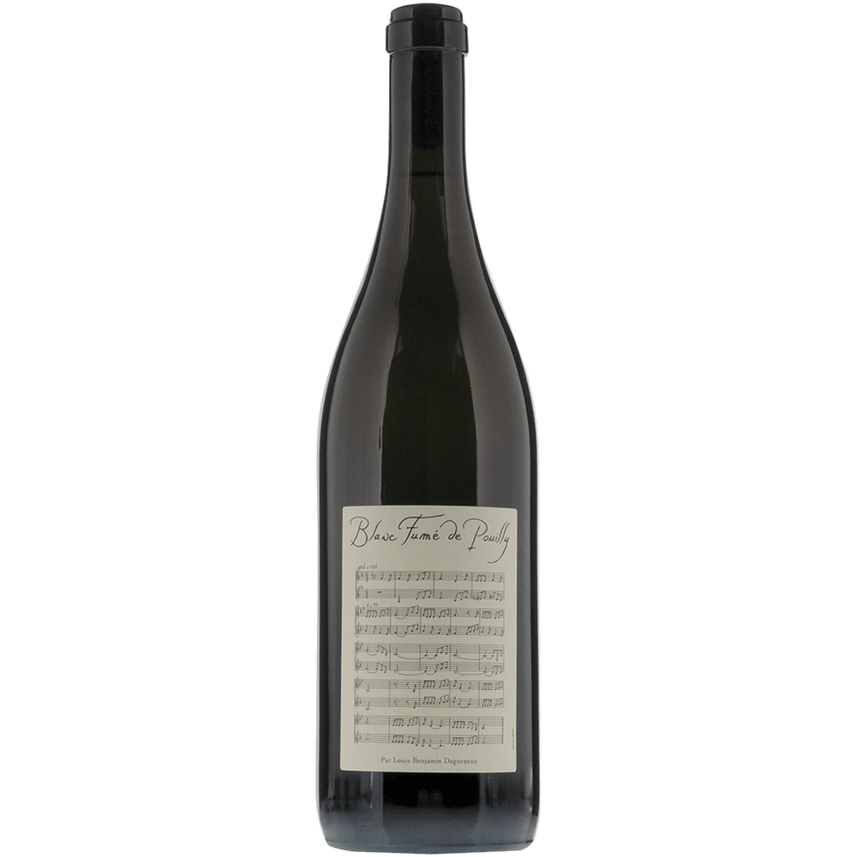
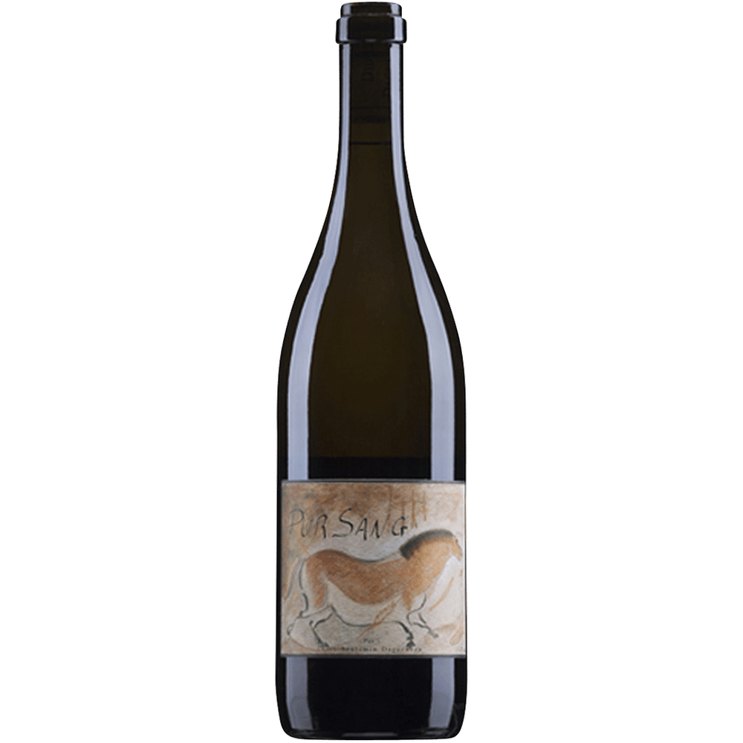
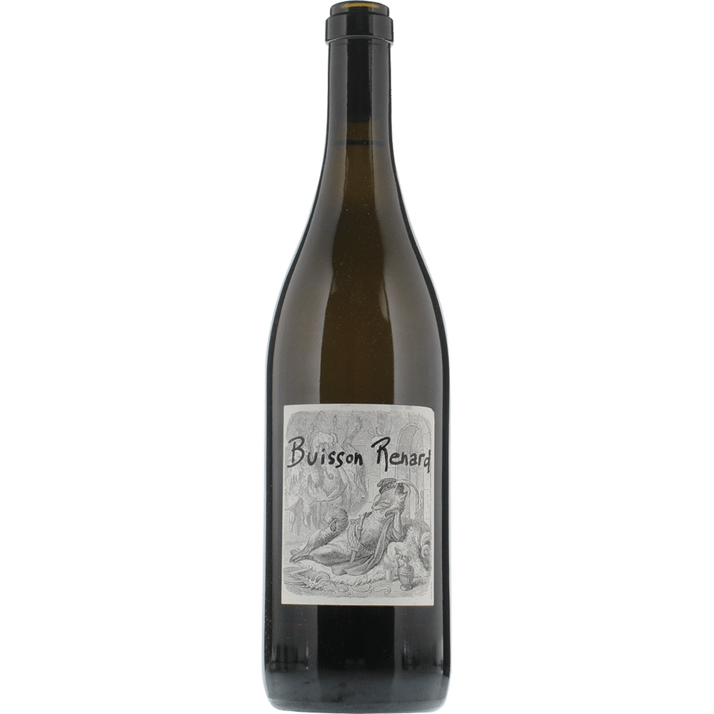
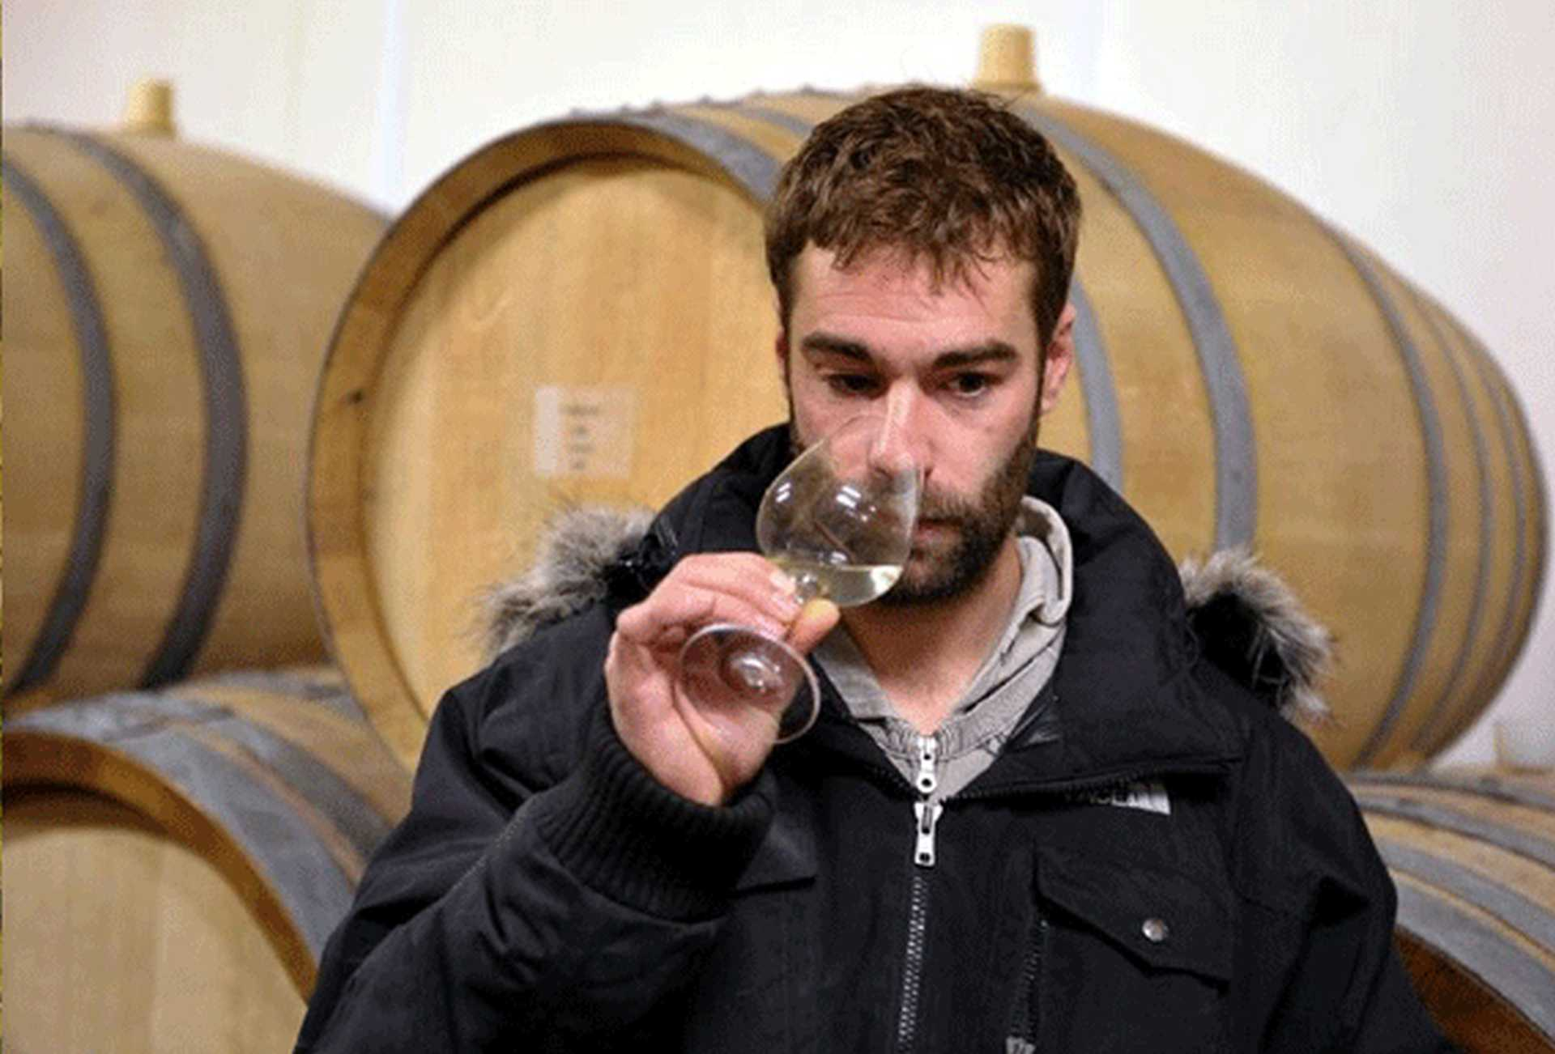
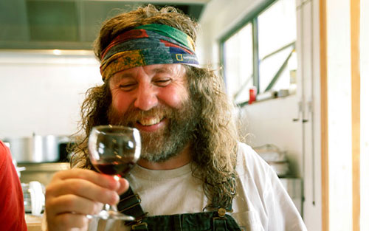
Family daguenau : a special and sad history
Didier Dagueneau was born in 1956 in Saint-Andelain, Nièvre, Burgundy. His winery with 12 hectares (30 acres) of vineyards was in the town of Saint-Andelain, in Pouilly Fumé. He was seeking to make "the best Sauvignon blanc in the world". He made a variety of different cuveés, including Buisson-Renard, Pur Sang (French for "pureblood"), Asteroïde, and Silex ("flint")
Somewhat unusually for the appellation and grape variety, many of his wines were meant for cellaring and some had a clear influence of oak. He was also developing vineyards in Jurançon.
An ex-motorcycle racer with no formal enological training, Dagueneau clashed with other winegrowers about typicity while achieving unprecedented prices for the region. His vineyard practices were a combination of the exacting (extremely low yields, hand harvesting in multiple passes) with the unusual, such as using horses to plow the soil between vines. He was described as a risk taker and an experimenter, with perfectionist attitudes to his work, cutting yields severely to achieve greater ripeness
He died on 17 September 2008, in an ultralight plane crash in the Cognac region of France. He is survived by two children with his ex-wife Martine, Benjamin and Charlotte, who work at the domaine, and two children with his partner Suzan Cremer, Aaron and Léon

Slide 22
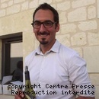
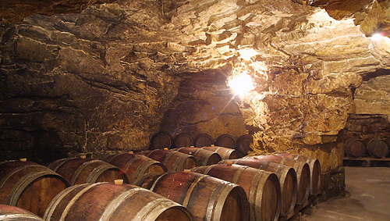
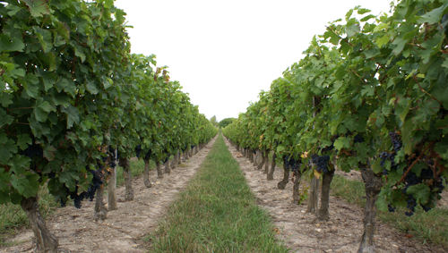
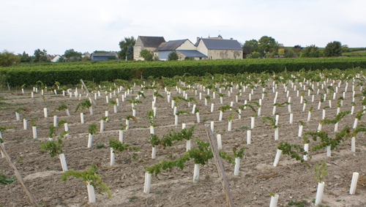
THIRD wine : chinon cuvee signee by romain parisis – vignobles du paradis
The vignobles du Paradis started in 1989 with the first planting of the 1st hectare of le Clos de la Niverdiere
In 1991, the first harvest has been very disappointing because of a very cold weather in France this year. In 1992 a new place was built for the wine making to take of the new vines of the Domaine de la Villardiere
In 1999 the vineyard has been extended on Beaumont-en-Veron
The vignobles du Paradis are working with a ESAT called the Chevaux Blancs employing people with handicap and help them to get in a better social life. The Vignobles du Paradis obtained 10 medals in 2015 to the famous contest in Tours, Macon and Angers, and a special price at the concours general Agricole de Paris

Slide 23
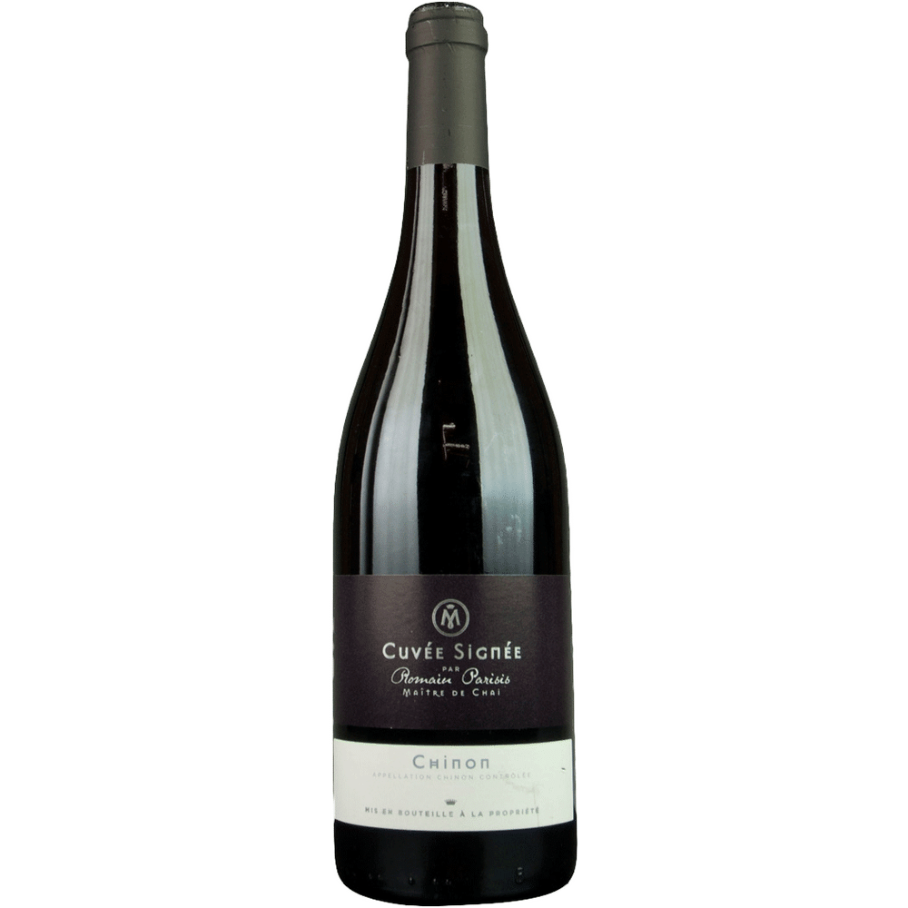
THIRD wine : chinon cuvee signee by romain parisis
100% Cabernet franc
Very youthful bright medium-ruby colour
Aromas suggest cedar, cinnamon and sour cherry
Dry, quite fruity with very light tannins
Medium bodied, perfect pairing with meat or winter barbecue !

Slide 24
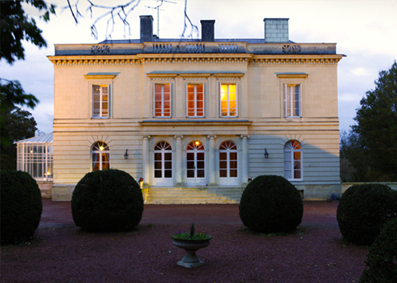
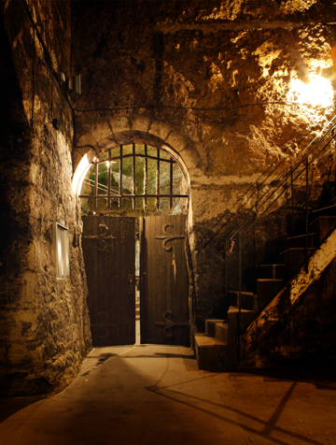
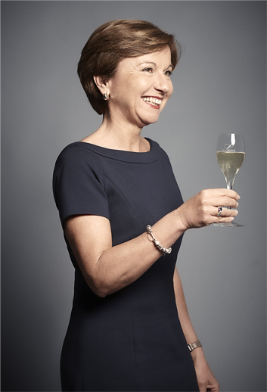
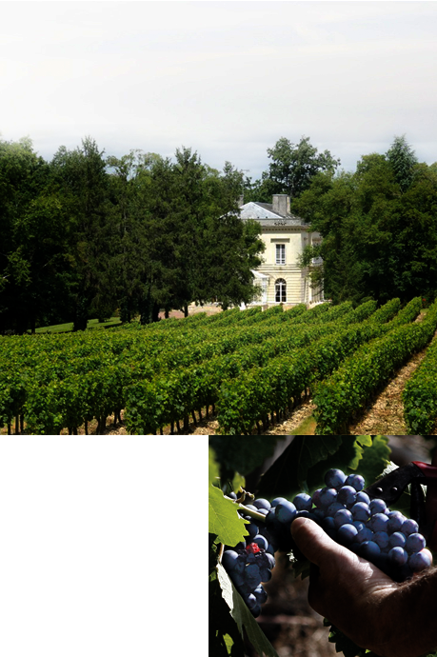
Last wine : Saumur rose de bussy
Maison Louis de Grenelle has been inspired by this same passion since 1859, and today is the last of the great independent Saumur family houses
In the heart of their cellars carved out of the tuffeau stone, they create their Fines Bulles wines with their delicate, refined and complex styles
La Durandière is the family estate. Françoise FLAO and her brother Antoine BODET cultivate 40 hectares of vineyards here, in keeping with the Maison's spirit and personality. With passion at the heart of her work, more than ever she cultivates her knowledge of the terroirs and the diversity of their grape varieties
The Louis de Grenelle style has been constructed over generations, today creating a range of unique wines, each with its own history

Slide 25
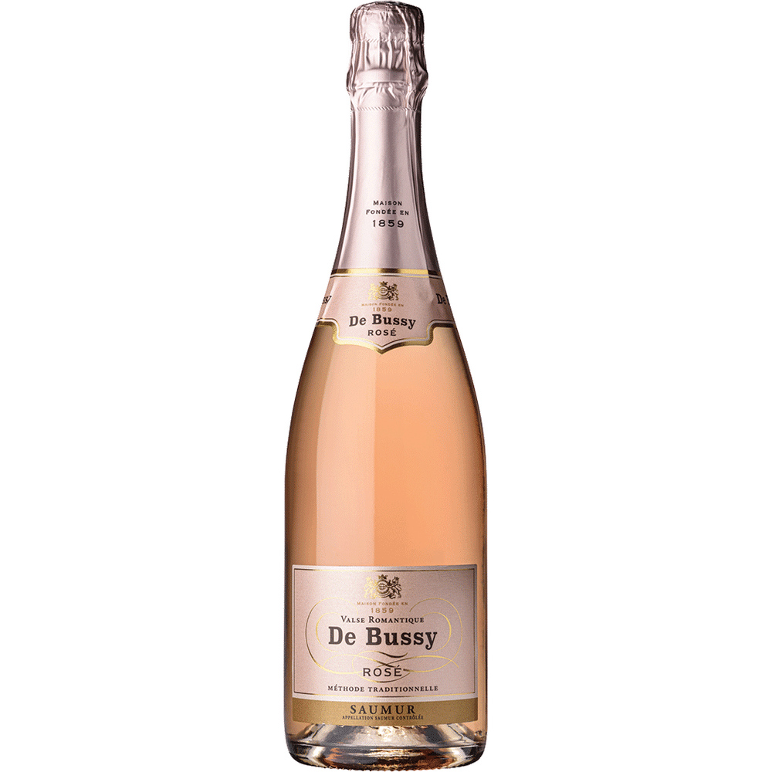
Last wine : Saumur rose de bussy
Grapes : 100% cabernet franc
Medium bodied
A rich and layered Cremant produced from Cabernet Franc
Notes of fresh red berries and citrus give this wine depth
Sweet while kept from cloying by its acidity, it is an opulent wine, with honey and fine almond and marzipan flavors at the end

Slide 26







Domaine des hauts de loire - onzain
There is nowhere that would allow visitors to appreciate all of the distinctive features of a French family residence as well as this former hunting lodge built in the 19th Century
Nowadays, guests arriving at the château are immediately greeted by Pierre Yermia’s monumental piece entitled Le Grand Cerf des Hauts de Loire (‘The Great Deer of the Hauts de Loire’) – a prime example of the property’s ability to incorporate art into its natural surroundings. The grounds themselves are, in fact, something of a living exhibition
Double-Michelin-starred chef Rémy Giraud has been running the kitchens at the Hauts de Loire for over 30 years and has lost none of his creativity, which strongly reflects his passion for nature, over that time
Hare terrine à la royale, eel salad and even Sologne caviar are just some of the dishes on offer here and sure to delight even the finest of palates. A great deal of sensitivity, creativity and incredible inventiveness goes into making this a flawless gastronomic experience

Slide 27



Who are the winners ???

Slide 28


Slide 29


Slide 30

Next wine tasting : 27th of may

